Slide 1
Lunch n’ Learn Angular
Frank Dong and Sharon Platkin

Slide 2


Notes:
Intro: who uses it? Google, paypal

Slide 3


TAKE LOGO’s AND MERGE
Notes:
Internal examples: backpack, etc.

Slide 4
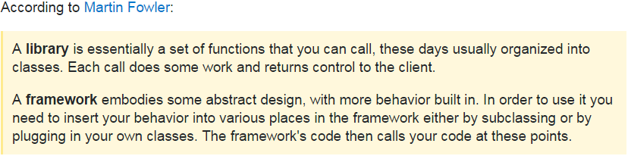
What is Angular?
Framework for building web apps
Single Page Application (SPA)
Notes:
What is angular? Single page app

Slide 5
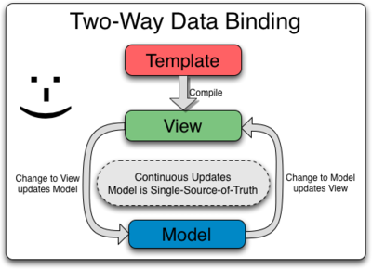
Angular vs AngularJS
AngularJS is the old version of Angular
Now the Angular framework makes it super easy to create custom tags
Typescript – a language similar to JavaScript
Improved Data Binding – DOM elements in Angular 2 can now be binded by [ ] brackets
Notes:
Angular vs AngularJS
Custom HTML tags are big
Had to learn a whole bunch of different things (controllers, restrict, controllerAs, and directives) all at once in order to create a custom html tag
Don’t have to remember a bunch of ng commands like ng-src or ng-click

Slide 6
Angular vs Other JS
AngularJS
Aurelia
Backbone.js
Cappuccino
Chaplin.js
Echo
Ember.js
Enyo
Ext JS
Google Web Toolkit
JavaScriptMVC
Knockout
Meteor
Mojito
MooTools
Prototype JavaScript Framework
React
Rialto Toolkit
SproutCore
Vue.js
Wakanda Framework
There’s a sh*t ton!
React
Facebook’s “framework” vs Googles framework
Library instead of framework
Virtual DOM = During DOM operations optimized and accelerated updates process
Notes:
Angular vs other JS

Slide 7
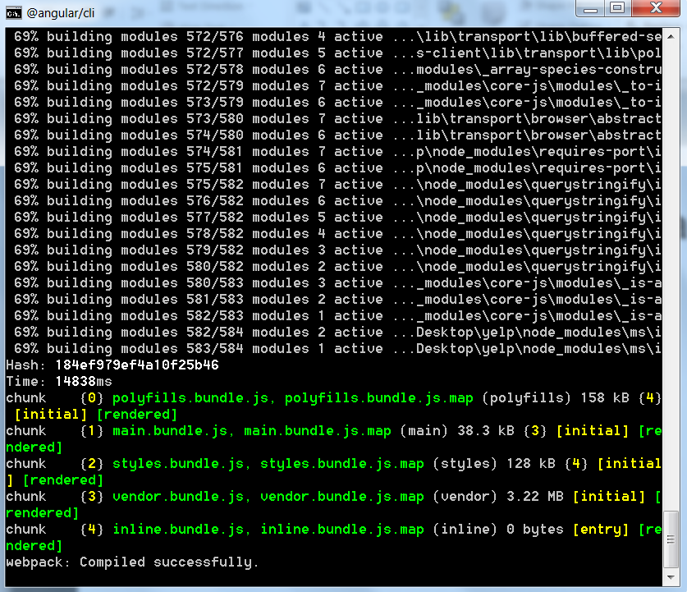
CLI – Command Line Interface
ng new
The Angular CLI makes it easy to create an application that already works, right out of the box. It already follows our best practices!
ng generate
Generate components, routes, services and pipes with a simple command. The CLI will also create simple test shells for all of these.
ng serve
Easily test your app locally while developing.
Notes:
Components:
CLI

Slide 8

The DOM
Document Object Model
The DOM is the way JavaScript sees its containing pages' data
It is an object that includes how the HTML/XHTML/XML is formatted, as well as the browser state
A DOM element is something like a DIV, HTML, BODY element on a page
You can add classes to all of these or add styling using CSS, or interact with them using JS
In our case AngularJS is interacting with DOM elements

Slide 9

Directives
Directives add behaviors to an existing DOM element
Example: can use directive to add a highlight on mouse hover
Structural directives – change the DOM layout by adding and removing DOM elements
Examples of these are the *NgFor and *NgIf statements
Modify view accordingly for the user
Attribute directives – change the appearance or behavior of an element, component or another directive
Gives objects an attribute such as the NgStyle directive which will provide css styling for your application
Notes:
Directives
Components
Include Template, styles, logic
Is considered the most famous type of directives
You can use other directives whether it’s a custom or built in directive in the @component annotation

Slide 10
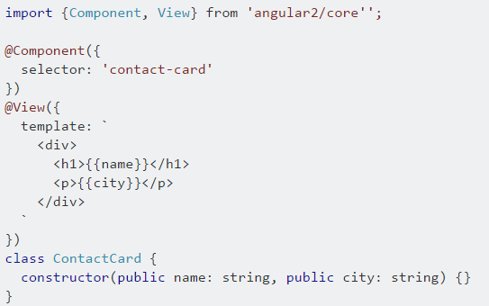
Components
Rather than adding behaviour to an existing DOM element, it creates it's own view with attached behaviour
A component is the most basic building block of an UI in an Angular application
Can reference the component using
<contact-card></contact-card>
Contact-card is now a reusable component that will display template when tags are used!
Notes:
Modules
A Component
An application is a tree of Angular components
Subset of directives, as explained previously
Unlike other directives, components always have a template and only one component can be instantiated per an element in a template

Slide 11
Modules
A module is combined with other modules to create an application
Groups components, directives, pipes and services that are related
How to organize modules?
No standard way but recommendations include
Features as a module
Shared utilities as a module
Notes:
Modules
Organizes application in cohesive blocks
Features as a Module
Example application has customer and product feature, each feature has some components / pipes / directives
Customer: CustomerListComponent, CustomerDetailComponent, CreateCustomerComponent, CustomerService
Product: ProductListComponent, ProductDetailComponent, CreateProductComponent, ProductService
Because these features are independent from each other, you may consider to create two modules: CustomerModule and ProductModule, then import these modules to AppModule later.
Shared Utilities as a module
For functions or features that are shared across modules and the application consider creating a shared module
Eg a translationModule that will be used by other moudles such as Customer and Product

Slide 12
Services
Angular services are substitutable objects that are wired together using dependency injection (DI). You can use services to organize and share code across your app.
Only instantiate a service when an application component depends on it.
Each component dependent on a service gets a reference to the single instance generated by the service factory.
Notes:
Services

Slide 13
Routing
Notes:
Routing

Slide 14

Typescript
Typescript is a Superset of JavaScript
This means typescript is able to process javascript = you don’t need to do big rewrites to migrate your code
Typescript Helps with large scale projects in terms of readability
Typescript makes code easier to read and understand
Provides a lot of information
Able to determine type (string, integer, Boolean, etc) of arguments in function
Javascript does not have types so it can make code error prone or confusing
Notes:
Typescript

Slide 15
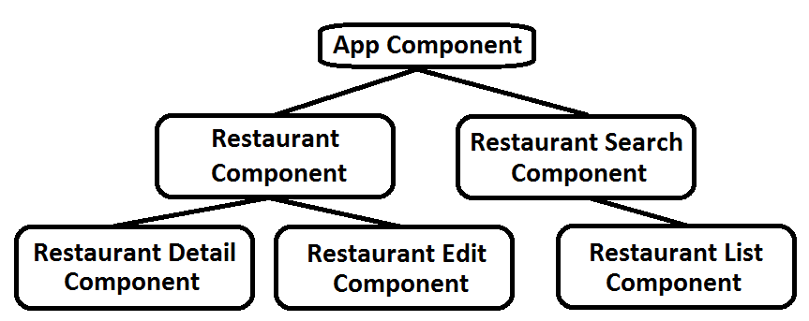
DEMO
Application Structure
Notes:
DEMO

Slide 16

Notes:
Questions?

